Slide 1
TESS: The Extraordinary Sudoku Solver
CSC-470 – Final Project Presentation | 4-21-17
By Team #1: David Koval and Joseph Mammo

Slide 2
Outline
Introduction
Goals
Requirements
System Model | Design
System Implementation
System Testing | Conclusion
Demo

Slide 3
Introduction
The popularity of Sudoku puzzles has increased dramatically over the past decades.
We are both avid Sudoku solvers.
About TESS
We focused on solving the regular 9x9 board.
We implemented a DFS with pruning to solve puzzles.
9⁸¹ = 196,627,050,475,552,913,618,075,908,526,912,116,283,103,450,944,214,766,927,315,415,537,966,391,196,809
We kept the design as simple as possible.

Slide 4
Goals
Problems:
Allowing the user to play a classic 9x9 sudoku game.
Designing an intuitive UI.
Managing difficulty levels.
Providing hints and error checks to the user.
Successfully solving a given sudoku game.
Finding an efficient algorithm to solve a game under 5 seconds.
Solutions:
Applied trial and error technique to solve UI issues.
Store existing puzzles in database based on difficulty.
Use DFS along with pruning to solve it within a reasonable time limit.

Slide 5
Requirements | Functional
ID: R1 – Play Game Option
1
ID:R2 – Select Difficulty
2
ID:R3 – Back Option
3
ID:R4 – Continue Game
4
ID:R5 – Get Puzzle
5
ID:R6 – Solver Option
6
ID:R7 – Input Sudoku Puzzle to Solve
7
ID:R8 – Check Current Board
8

Slide 6
Requirements | Functional
ID: R9 – Delete an Input Value
1
ID:R10 – Clear Board
2
ID:R11 – Solve Current Board
3
ID:R12 – Play Sudoku Game
4
ID:R13 – Hint Option
5
ID:R14 – Download Mobile Application
6

Slide 7
Requirements | Non-Functional
ID: R1 – System Availability
1
ID:R3 – Search Algorithm
3
ID:R4 – Pruning Technique
4
ID:R5 – Database Storage
5
ID:R6 – Easy to Use
6
ID:R7 – Private Information
7
ID:R2 – Solve Time
2

Slide 8
System Design | Overview
(Design overview; interaction, structural models)

Slide 9
System Design | Prototyping
Figure 1: The top four design iterations of TESS.

Slide 10
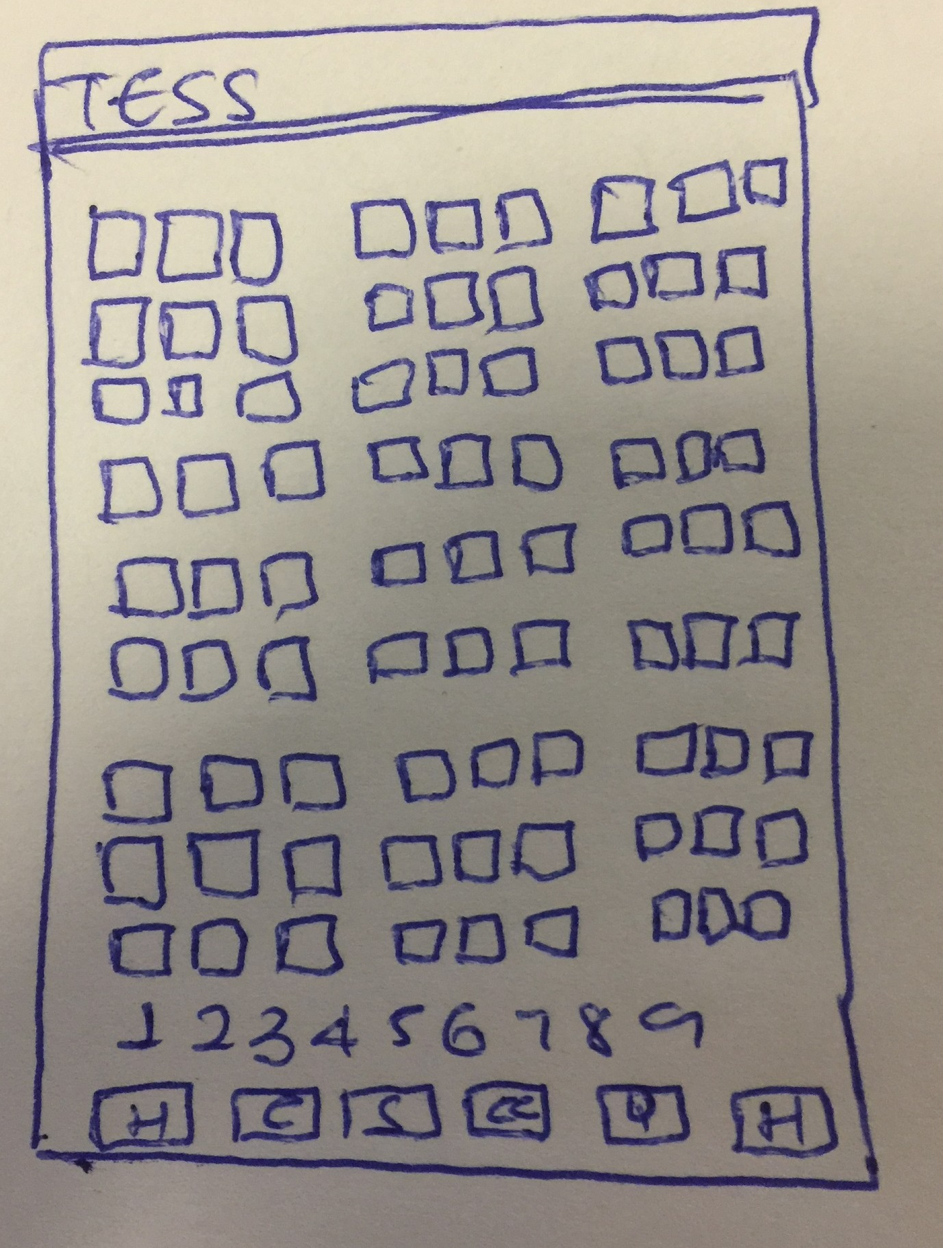
System Design | User Constraints
Client proposed the following design outlined in figure 1.
Simple design.
9x9 classic Sudoku game.
Play, input or solve a Sudoku game.
Figure 2: User constraint of TESS.

Slide 11
System Design | System Constraints
ID:C1 – Memory Space
ID:C2 – Internet Connection for Updates
ID:C3 – Programming Language
ID:C4 – Android Device Only
ID:C5 – Time to Solve
ID:C6 – Database Usage

Slide 12
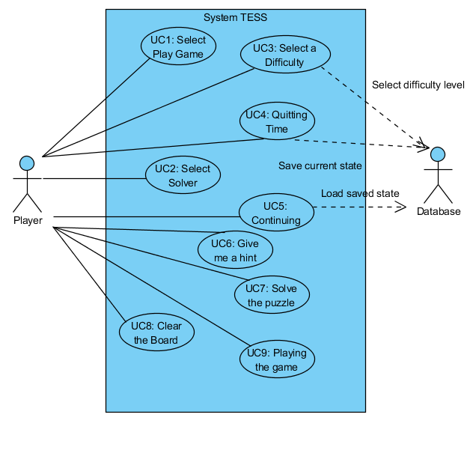
System Model | Use Case
Actors:
Player
Database
Use Cases:
ID:UC1 – Select Play Game
ID:UC2 – Select Solver
ID:UC3 – Selecting a difficulty
ID:UC4 – Quitting Time
ID:UC5 – Continuing
ID:UC6 – Give me a hint
ID:UC7 – Solve the Puzzle
ID:UC8 – Clear the Board
ID:UC9 – Playing the game
Figure 3: Use case diagram of TESS.

Slide 13
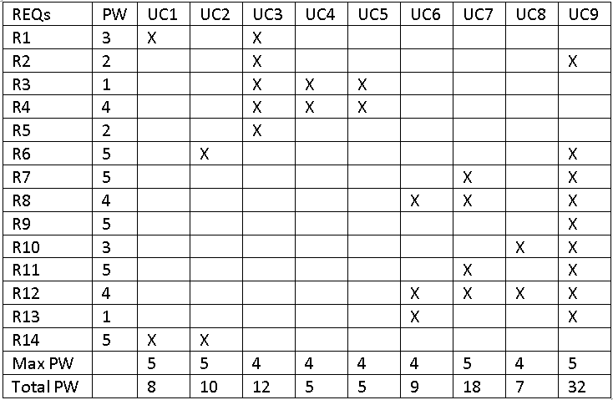
System Model | Traceability Matrix
Figure 4: Traceability matrix of the use cases.

Slide 14
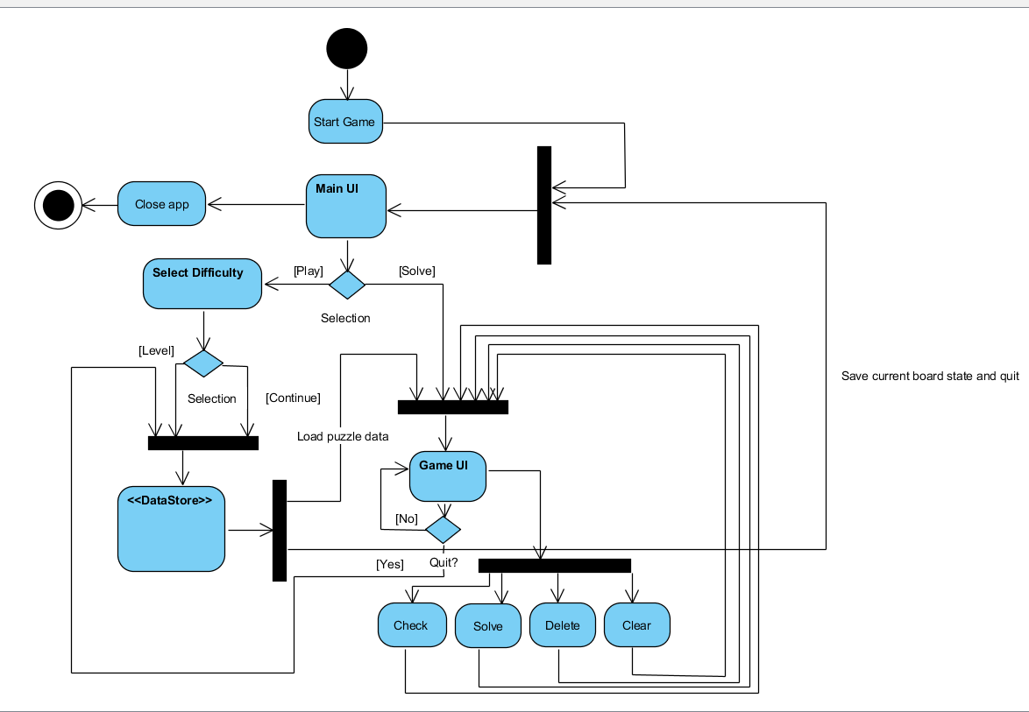
System Implementation| Activity Diagram
Figure 5: Activity diagram of TESS.

Slide 15
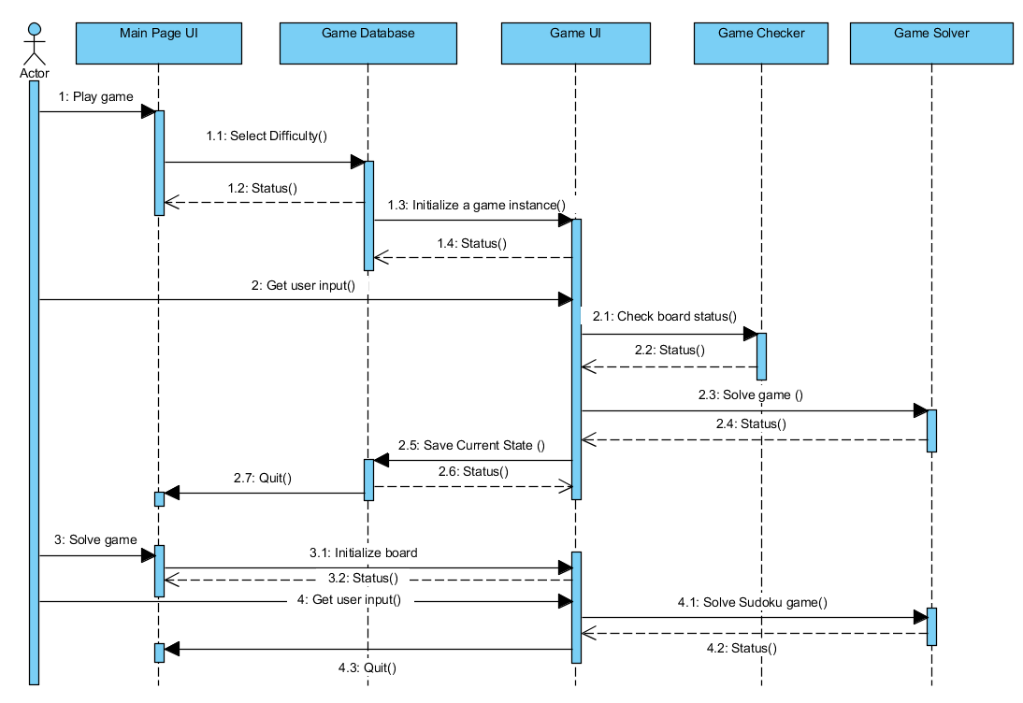
System Implementation | Sequence Diagram
Figure 6: Sequence diagram of TESS.

Slide 16
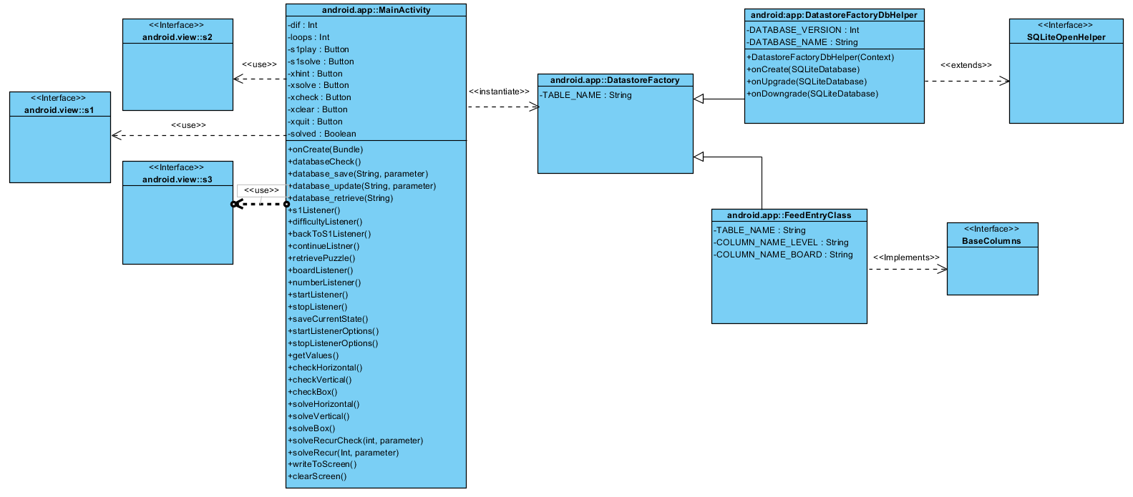
System Implementation | Class Diagram
Figure 7: Class diagram of TESS.

Slide 17
Software Process Model
We executed the Extreme Programming (XP) software process model.
Mainly implemented incremental development model
Full time customer engagement
Paired programming
Incrementally developed and got feedback from our alpha and beta testers (i.e. close friends and families).

Slide 18


Slide 19
Conclusions
TESS allows the user to play classic 9x9 Sudoku games based on five difficulty levels.
TESS allows the user to input a sudoku puzzle and it will solve it in seconds.
TESS saves the current progress of the user on a database entry, allowing users to resume their game even after closing the app.

Slide 20
Future Work
Improve
Improve solving efficiency by implementing the paper-and-pen algorithm.
Open
Open-source TESS so anyone can adapt and improve our code.
Publish
Publish TESS on the Play Store for free download.
Add
Add more challenging levels based on the difficulty levels.

Slide 21
References
[1] Ivan Marsic, Software Engineering; Appending G.
[2] Fakhroutdinov, Kirill. "Android Camera." UML graphical notation overview, examples, and reference. N.p., 10 Dec. 2015. Web. 11 Apr. 2017.
[3] Icons and images: http://www.iconarchive.com | www.freeiconspng.com/icons | https://openclipart.org http://keywordsuggest.org | http://www.pngall.com/thank-you-png

Slide 22

Sample Footer Text
4/21/2017
22
TESS by David Koval and Joseph Mammo

